Slide 1

Health and WELLBEING survey
A survey for young people
Schools and Students Health Education Unit, Exeter

Slide 2
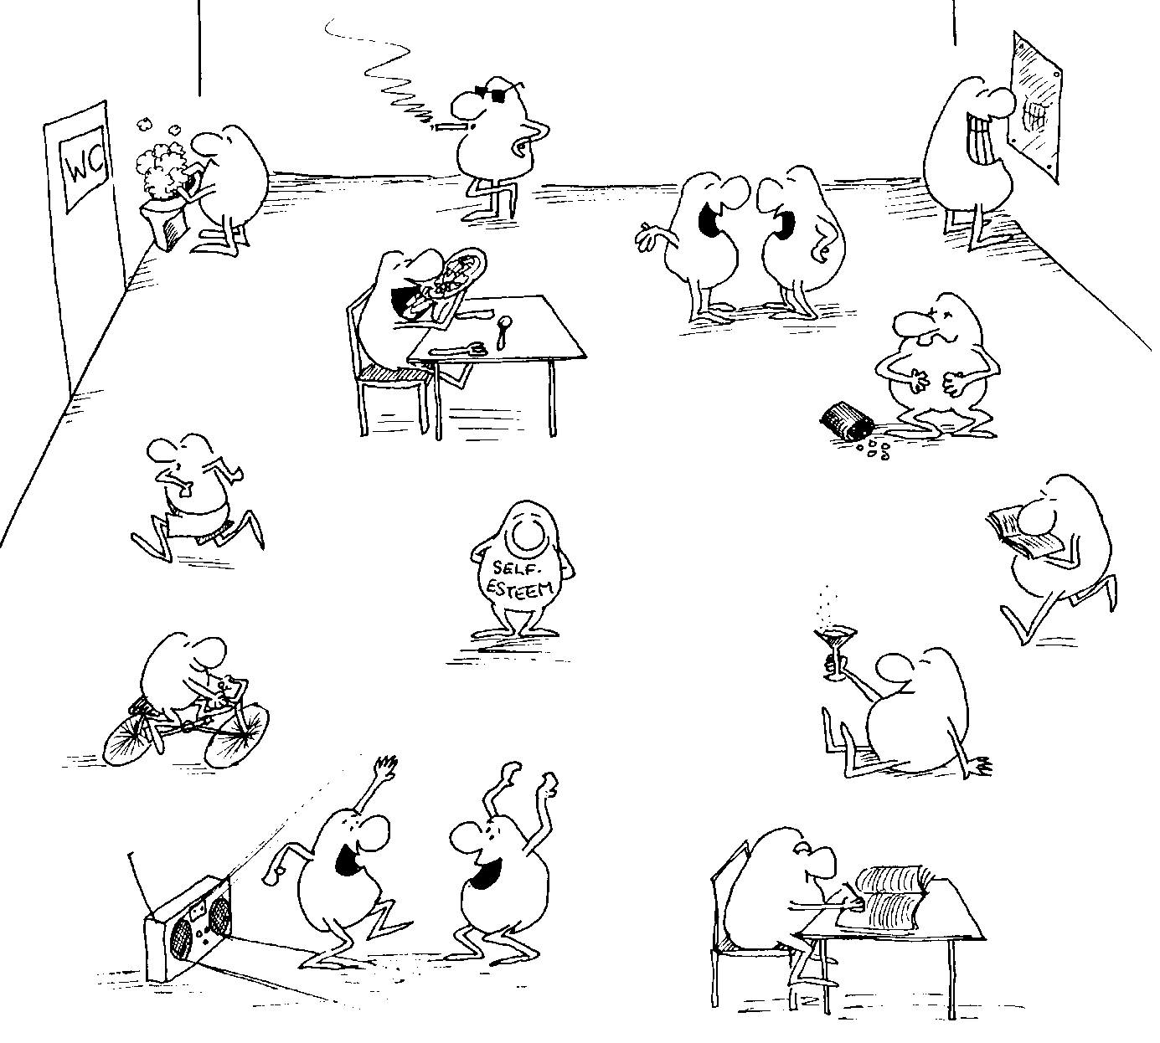
WHAT IS IT?
What’s the point?
It’s a survey about:
your health,
your safety,
how you are feeling, and
learning at school
This is one of the biggest health surveys in the UK, and since 1977 hundreds of thousands of people your age have taken part.
Answers from young people help the school and the Council in their planning to look after you and other people your age

Slide 3
What happens afterwards?
(example council)
We find out some important things about young people
We do lots of work in response
  e.g. Y6 pupils spending money on fizzy drinks increased 2010-2016:
  14%, 14%, 19%, 23%
  In 2016, 74% of secondary school pupils worried about at least one problem ‘quite a lot’ or ‘a lot.
  Schools had discussions with School Council
  Schools changed some of their lessons
  The Council met with groups of young people e.g. pupils who are Young Carers
  The Council gave schools new advice

Slide 4


Is it safe?
No one will find out your answers
You don’t put your name anywhere on the questionnaire
All questionnaires are private and once you have finished they will not be read by anyone connected with the school.
The school gets only the overall percentages, not individual answers (so, we might find out that 5% of pupils eat chips every day – but we won’t know who)
All the completed paper questionnaires will be destroyed not kept
The results will be kept safe by the research team.

Slide 5

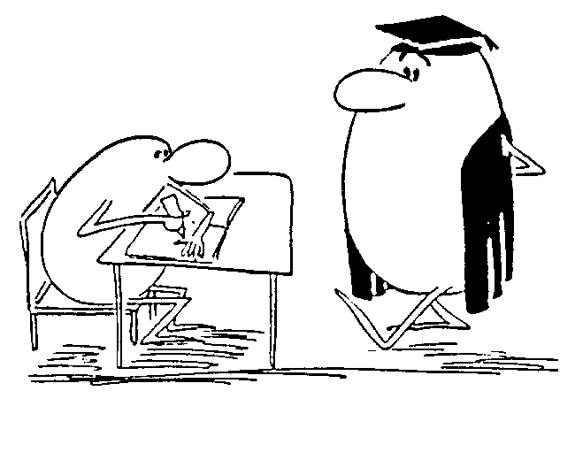
How DO I take part?
Some schools do it online, some on paper
Do I have to take part?
Of course, you can leave out any question that you don't want to answer, but we hope you will want to take part and enjoy the exercise.
We also hope that you will have a chance to discuss some of the results in class lessons.
If you do not want to take part in this study at all, please let your teacher know.

Slide 6


More about taking part…
It is really important that the information collected must be accurate; therefore we want only your honest answers.
        For example, if you did not wash your hair yesterday, even though you normally do every day, please tell us the true answer for yesterday.
The questionnaire is not a test and you can ask for help whenever you need it (put your hand up as usual)
If you make a mistake, just correct it - the research team will make sense of it

Slide 7
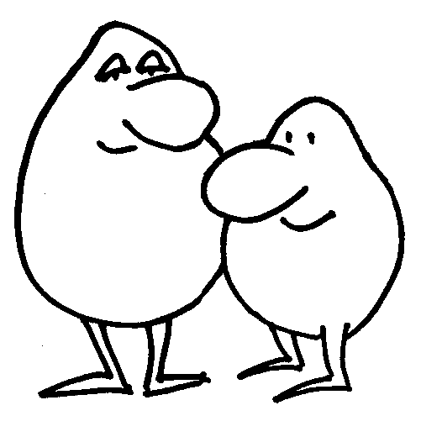
THINGS TO WATCH FOR (1)
Your survey may ask about young carers. There is a definition of ‘young carer’ for the survey:
        Young carers are people under 18 who offer substantial, regular, help to a parent, grandparent, brother or sister who has a disability or mental health, drug or alcohol issues.
We are not asking if you care about your parents, nor if you occasionally help out at home.
Your survey may ask about parents/carers in the armed forces. We are asking only about Mum, Dad and other guardians or carers in the home, not other family members or relatives, even if you are really proud of them.

Slide 8
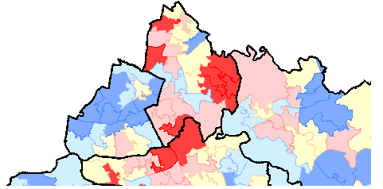
THINGS TO WATCH FOR (2)
Your survey may ask for postcodes. The Council would find it really helpful to be able to draw maps of the results, so we would like as many full postcodes to be collected as possible.
No-one will find out who you are or write to you at home.
SHEU do not store your whole plain postcode with the rest of your answers.

Slide 9

If you want to talk to someone about anything in the survey, please let a teacher know
or
ring ChildLine 0800 1111

